Slide 1
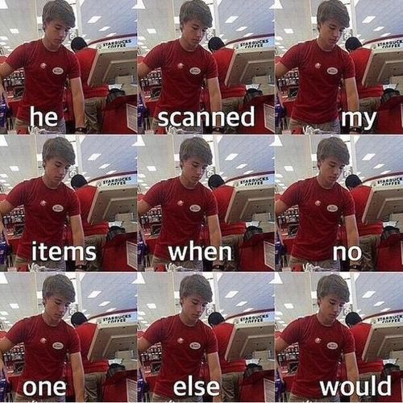
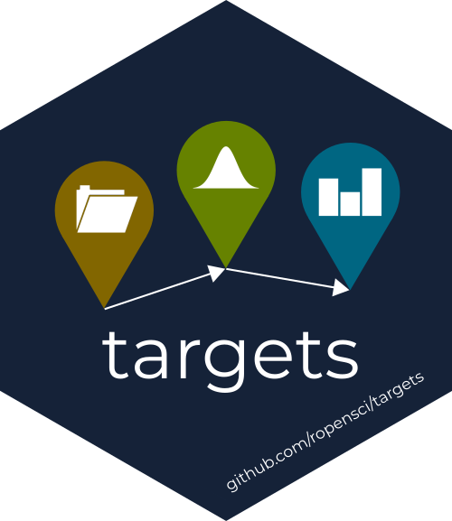
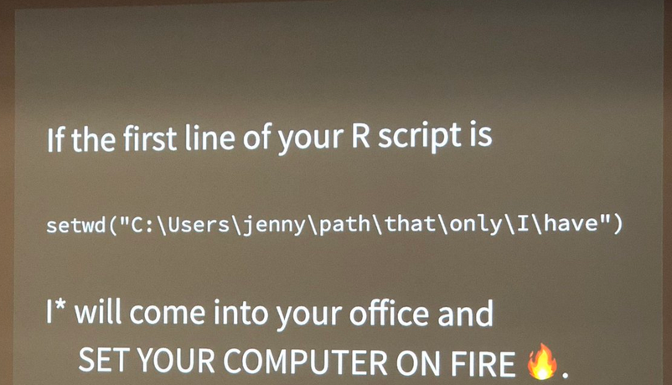
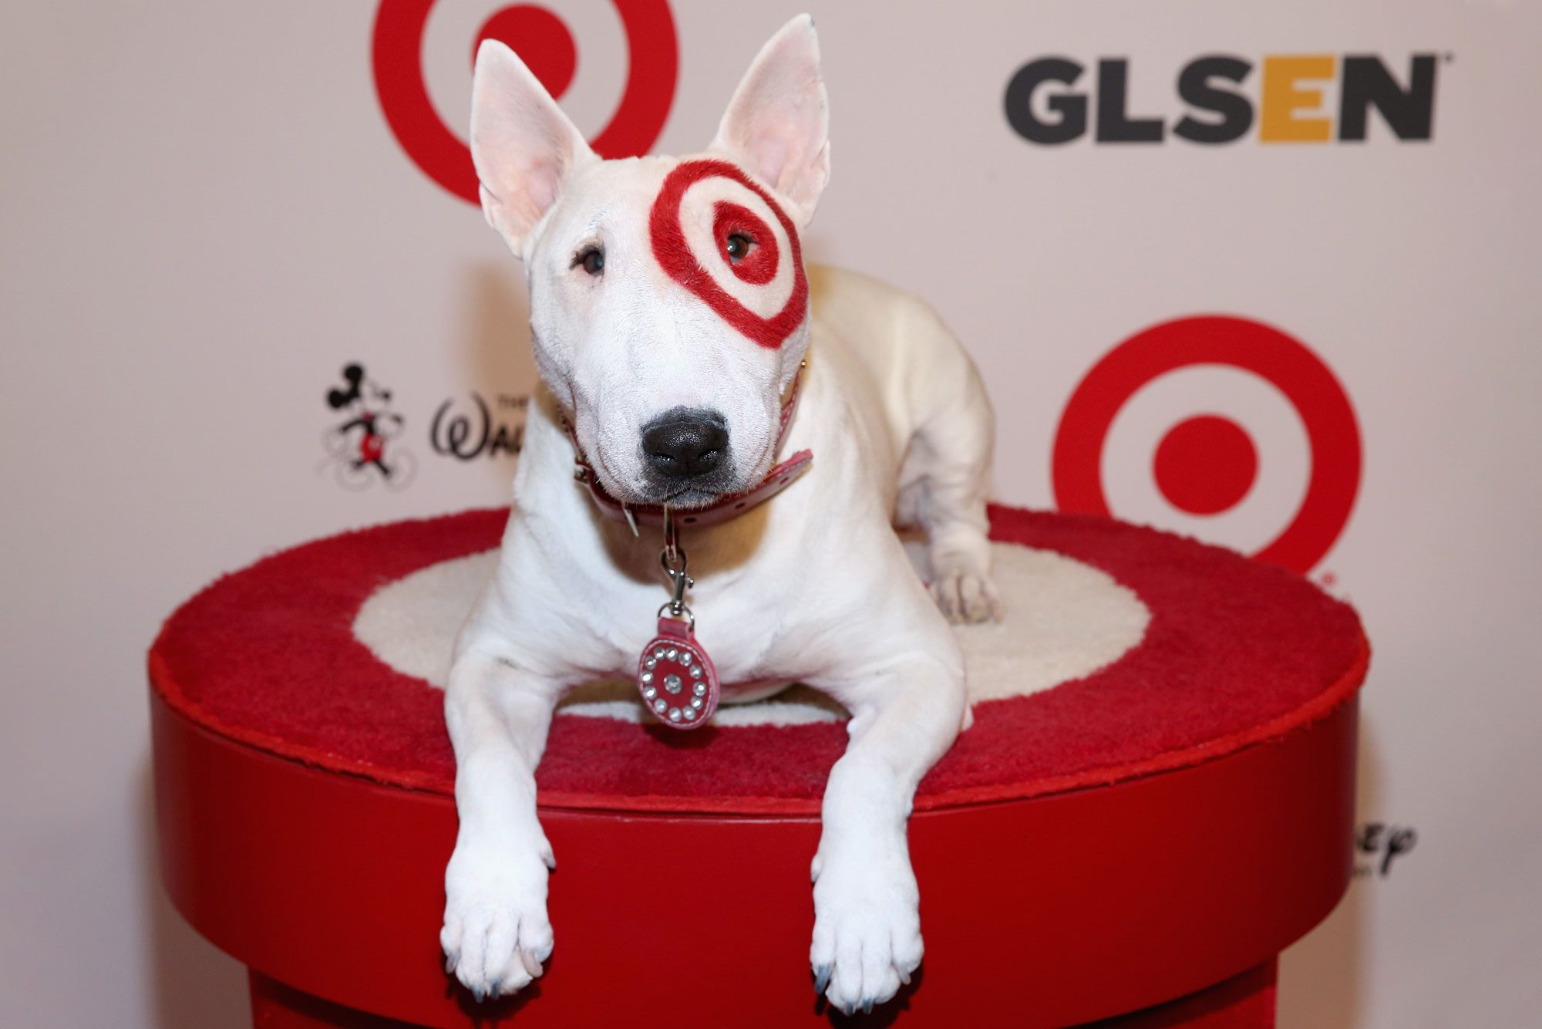
BULLSEYE!
Hit reproducibility with t a r g e t s in R
Murphy John
2025-09-25
rm(list=ls())

Slide 2


Chronic Sisyphean coding loop
Analogy by Will Landau, t a r g e t s developer

Slide 3
Chronic Sisyphean coding loop
Write code for project
Analogy by Will Landau, t a r g e t s developer

Slide 4
Chronic Sisyphean coding loop
Write code for project
Run entire project and wait
Analogy by Will Landau, t a r g e t s developer

Slide 5
Chronic Sisyphean coding loop
Write code for project
Run entire project and wait
Discover an error
Or your advisor (@ Andreas) tells you to change your analysis🙂
Analogy by Will Landau, t a r g e t s developer

Slide 6
Chronic Sisyphean coding loop
Write code for project
Run entire project and wait
Discover an error
Or your advisor (@ Andreas) tells you to change your analysis🙂
Clear working directory (maybe)
Analogy by Will Landau, t a r g e t s developer

Slide 7
Chronic Sisyphean coding loop
Write code for project
Run entire project and wait
Discover an error
Or your advisor (@ Andreas) tells you to change your analysis🙂
Clear working directory (maybe)
Repeat
Analogy by Will Landau, t a r g e t s developer

Slide 8
Chronic Sisyphean coding loop
Write code for project
Run entire project and wait
Discover an error
Or your advisor (@ Andreas) tells you to change your analysis🙂
Clear working directory (maybe)
Repeat
Interactive coding sessions (ie storing objects in the environment) can be time consuming, unorganized, and difficult to reproduce.
Analogy by Will Landau, t a r g e t s developer

Slide 9
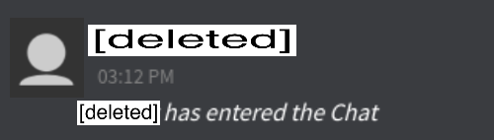
Chronic Sisyphean coding loop
Write code for project
Run entire project and wait
Discover an error
Or your advisor (@ Andreas) tells you to change your analysis🙂
Clear working directory (maybe)
Repeat
t a r g e t s
t a r g e t s
t a r g e t s
t a r g e t s
Interactive coding sessions (ie storing objects in the environment) can be time consuming, unorganized, and difficult to reproduce.
Analogy by Will Landau, t a r g e t s developer

Slide 10
What is t a r g e t s?

Slide 11
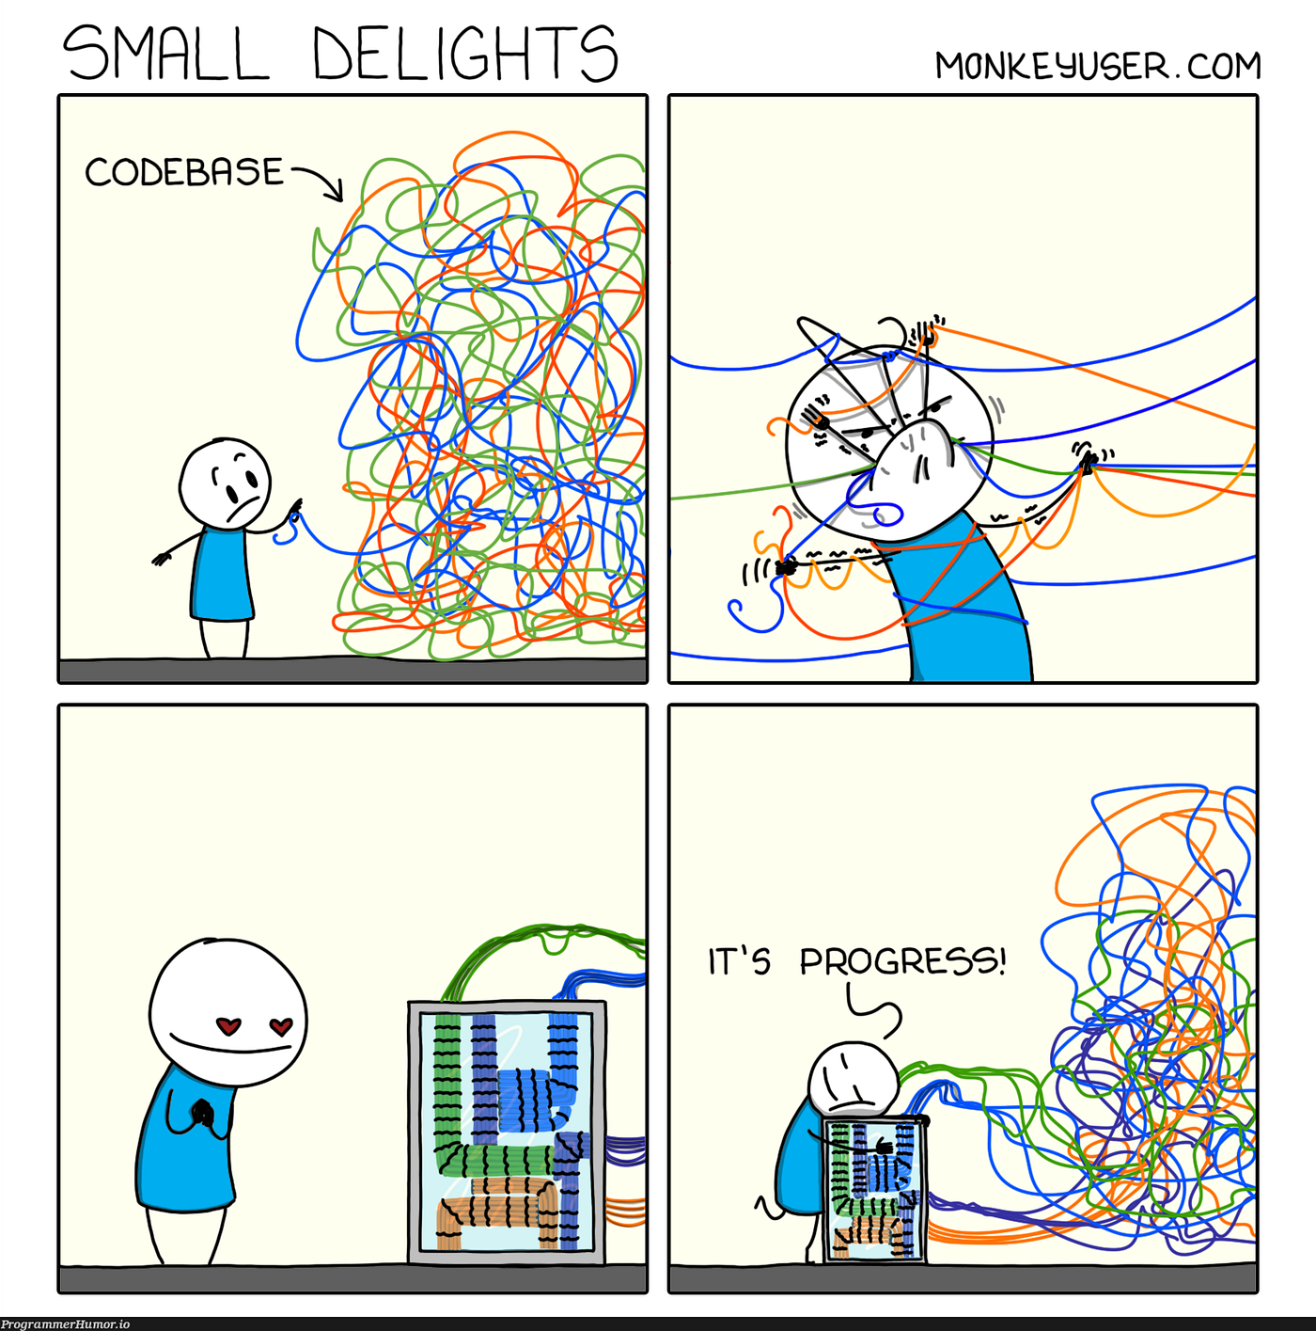
What is t a r g e t s?
targets is an R package that organizes and tracks all components of an analytical pipeline

Slide 12
What is t a r g e t s?
targets is an R package that organizes and tracks all components of an analytical pipeline
Monitors code and outputs for changes so results stay current

Slide 13
What is t a r g e t s?
targets is an R package that organizes and tracks all components of an analytical pipeline
Monitors code and outputs for changes so results stay current
Re-runs only modified steps and their downstream dependencies

Slide 14
What is t a r g e t s?
targets is an R package that organizes and tracks all components of an analytical pipeline
Monitors code and outputs for changes so results stay current
Re-runs only modified steps and their downstream dependencies
Flags steps with pending changes so you know exactly where to work

Slide 15
What is t a r g e t s?
targets is an R package that organizes and tracks all components of an analytical pipeline
Monitors code and outputs for changes so results stay current
Re-runs only modified steps and their downstream dependencies
Flags steps with pending changes so you know exactly where to work
An organized workflow is an efficient and reproducible workflow!

Slide 16
Things I love about t a r g e t s😍

Slide 17
Things I love about t a r g e t s😍
Functional coding!!!
Feels weird at first, but it’s SO efficient

Slide 18
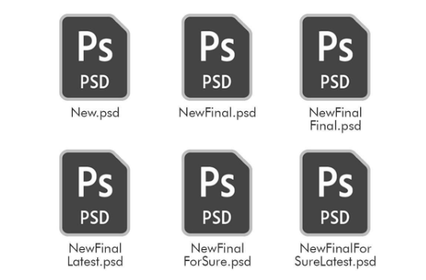
Things I love about t a r g e t s😍
Functional coding!!!
Feels weird at first, but it’s SO efficient
Everything gets saved (and updated) automatically in the “_targets/” folder, so you don’t end up with a million random files floating around

Slide 19
Things I love about t a r g e t s😍
Functional coding!!!
Feels weird at first, but it’s SO efficient
Everything gets saved (and updated) automatically in the “_targets/” folder, so you don’t end up with a million random files floating around
Having one “master” file with all your targets makes the whole workflow way more organized and easier to follow

Slide 20
Things I love about t a r g e t s😍
Functional coding!!!
Feels weird at first, but it’s SO efficient
Everything gets saved (and updated) automatically in the “_targets/” folder, so you don’t end up with a million random files floating around
Having one “master” file with all your targets makes the whole workflow way more organized and easier to follow
Targets has parallel processing built in, so things run faster, and you don’t have to mess with setting it up yourself

Slide 21
Things I love about t a r g e t s😍
Functional coding!!!
Feels weird at first, but it’s SO efficient
Everything gets saved (and updated) automatically in the “_targets/” folder, so you don’t end up with a million random files floating around
Having one “master” file with all your targets makes the whole workflow way more organized and easier to follow
Targets has parallel processing built in, so things run faster, and you don’t have to mess with setting it up yourself
Reproducibility is basically forced along the way so when you come back months later (or hand it off to someone else), the pipeline is clear and still works

Slide 22
Still haven’t turned your head?

Slide 23


Still haven’t turned your head?
a hot new bombshell (function) has entered the villa
tar_visnetwork()

Slide 24
tar_visnetwork()

Slide 25
tar_visnetwork()
Visualizes your entire pipeline with a dependency graph (similarish to a DAG)

Slide 26
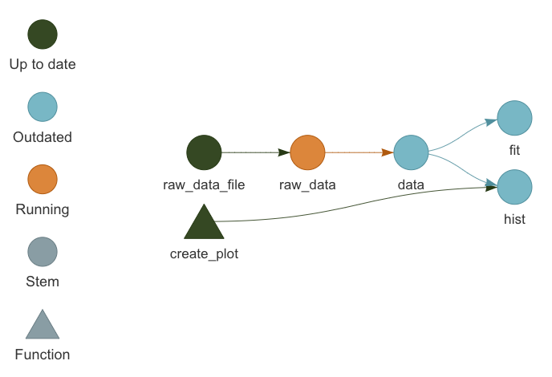
tar_visnetwork()
Visualizes your entire pipeline with a dependency graph (similarish to a DAG)

Slide 27
tar_visnetwork()
Visualizes your entire pipeline with a dependency graph (similarish to a DAG)
Who cares?! 🥱
That pipeline is super straightforward. 😴
I can easily remember that! 😏

Slide 28
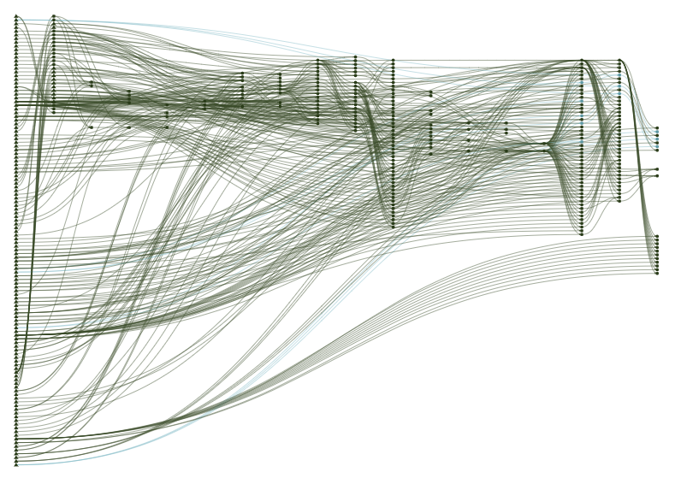
tar_visnetwork()
Visualizes your entire pipeline with a dependency graph (similarish to a DAG)
😮
Who cares?! 🥱
That pipeline is super straightforward. 😴
I can easily remember that! 😏

Slide 29
Setting up a t a r g e t s project

Slide 30
Set up

Slide 31
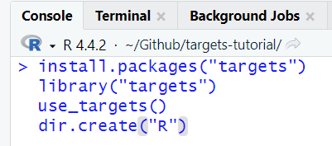
Set up
Create an R project
Install and load the targets package
Run “use_targets()” to create a “_targets.R” file
Create a folder called “R” where you will store custom functions

Slide 32
_targets.R file

Slide 33
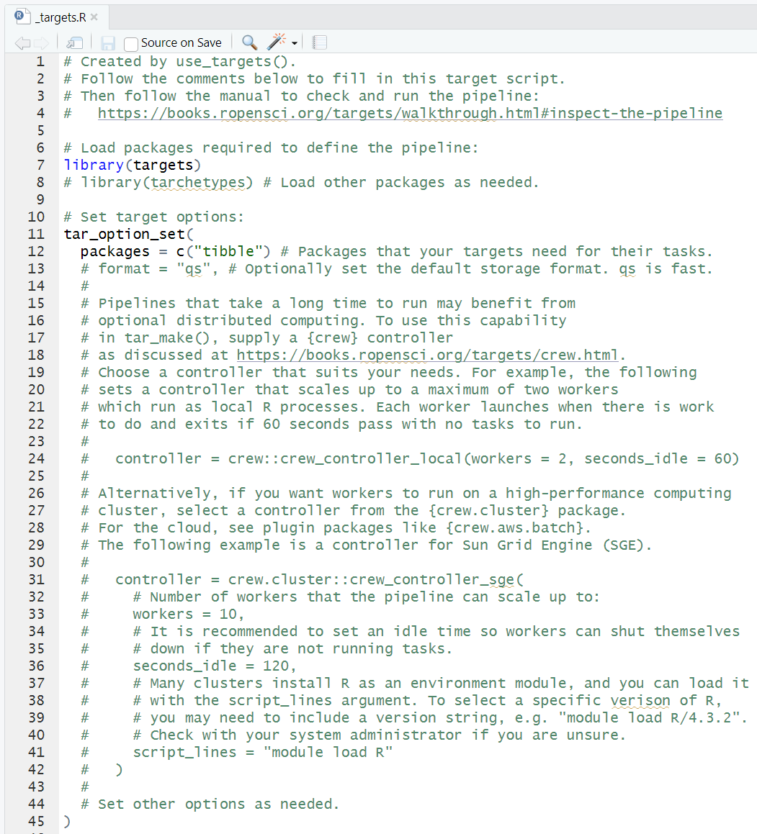
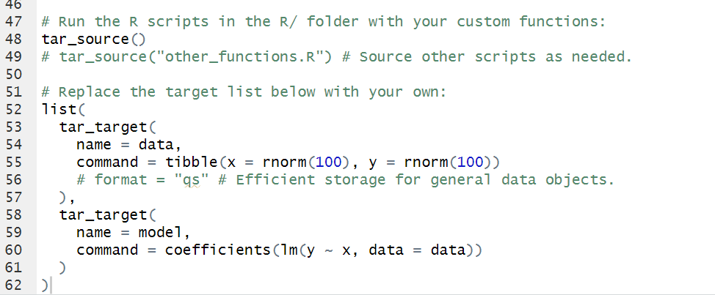
_targets.R file
The “master” file of your projects
Load packages
Set targets options
Load custom functions
Set up targets pipeline

Slide 34
Things I always set up in the _targets.R file

Slide 35
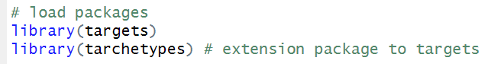
Things I always set up in the _targets.R file
Load `targets` and `tarchetypes`

Slide 36
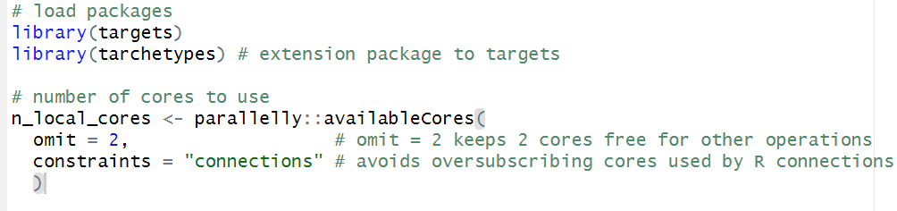
Things I always set up in the _targets.R file
Load `targets` and `tarchetypes`
Maximize the number of CPU cores being used

Slide 37
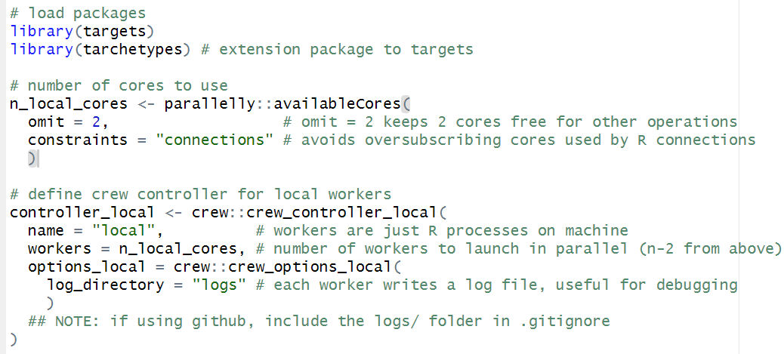
Things I always set up in the _targets.R file
Load `targets` and `tarchetypes`
Maximize the number of CPU cores being used
Specify parallel processing features and write log files for debugging

Slide 38
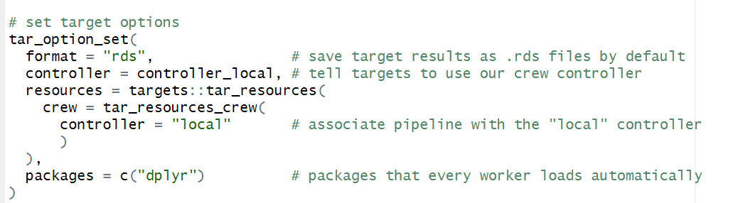
Things I always set up in the _targets.R file
Load `targets` and `tarchetypes`
Maximize the number of CPU cores being used
Specify parallel processing features and write log files for debugging
Some other `targets` specifications

Slide 39
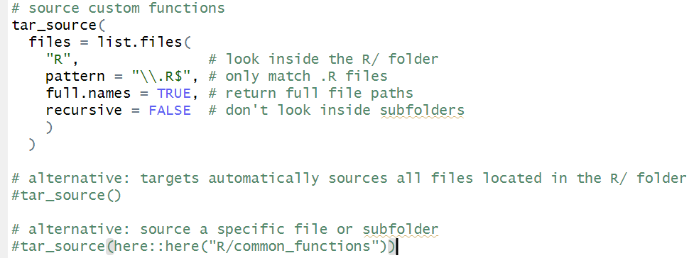
Things I always set up in the _targets.R file
Load `targets` and `tarchetypes`
Maximize the number of CPU cores being used
Specify parallel processing features and write log files for debugging
Some other `targets` specifications
Source custom functions for workflow

Slide 40
Example t a r g e t s project

Slide 41

ggplot2::diamonds dataset
Prices and other attributes of about 54,000 diamonds
How do carat, cut, color, and clarity influence diamond price?
TODO:
Load and process data
EDA
Fit a model
Plot results
Save results

Slide 42
Load and process data

Slide 43
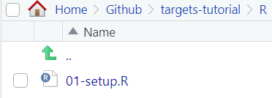
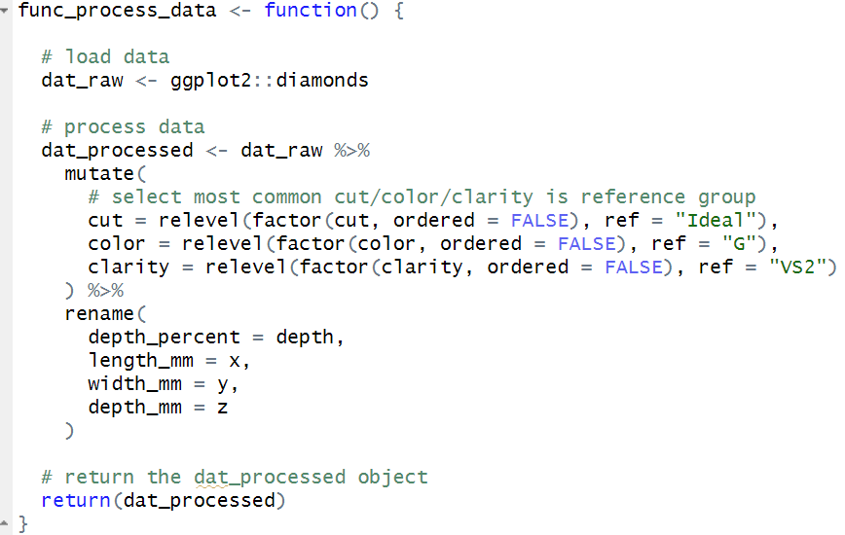
Load and process data
Write a function that loads and processes the data

Slide 44
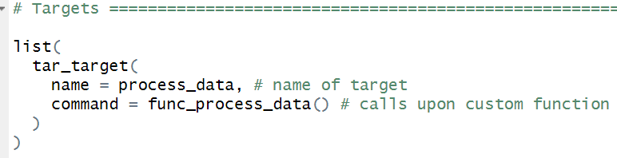
Load and process data
Write a function that loads and processes the data
Add function to a target in the _targets.R file

Slide 45
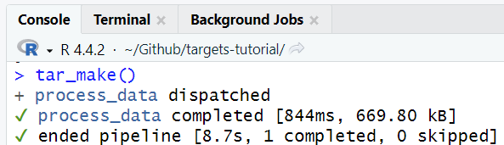
Load and process data
Write a function that loads and processes the data
Add function to a target in the _targets.R file
Run t a r g e t s workflow!

Slide 46
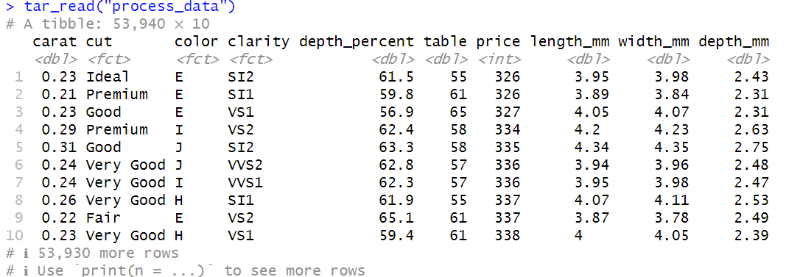
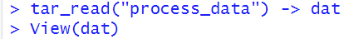
Load and process data
Write a function that loads and processes the data
Add function to a target
Run t a r g e t s workflow!

Slide 47
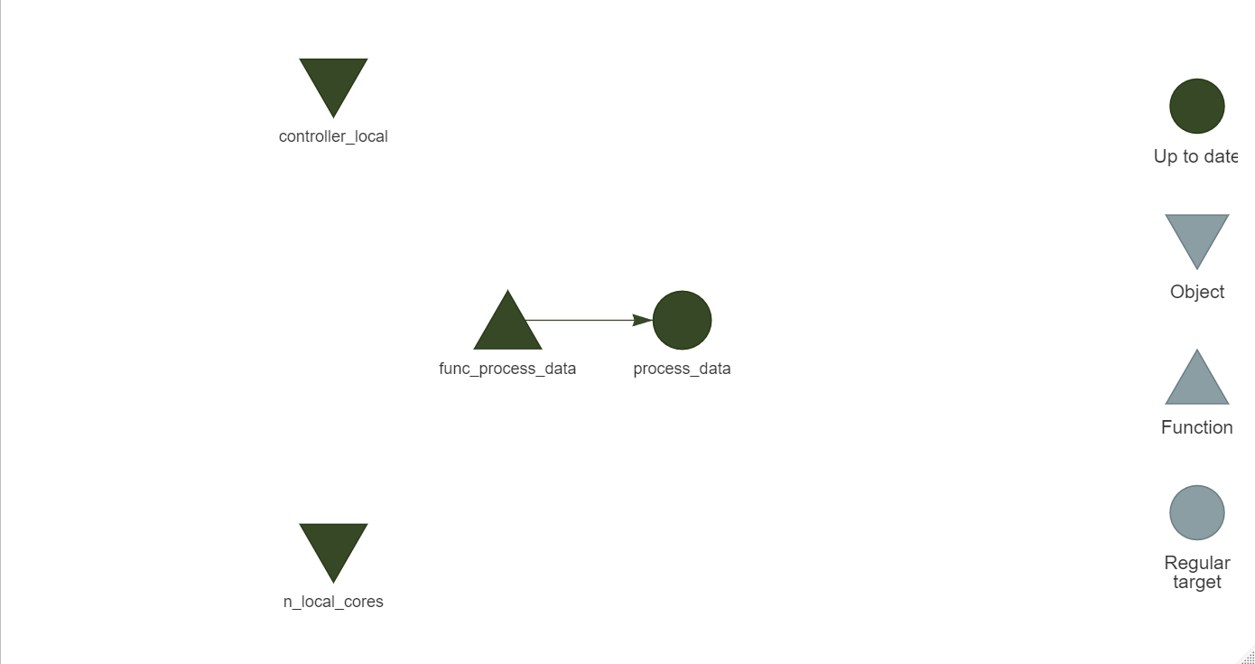
Load and process data
Write a function that loads and processes the data
Add function to a target
Run t a r g e t s workflow!

Slide 48
EDA

Slide 49
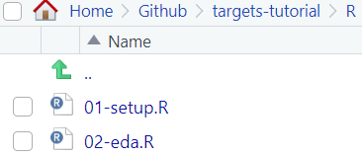
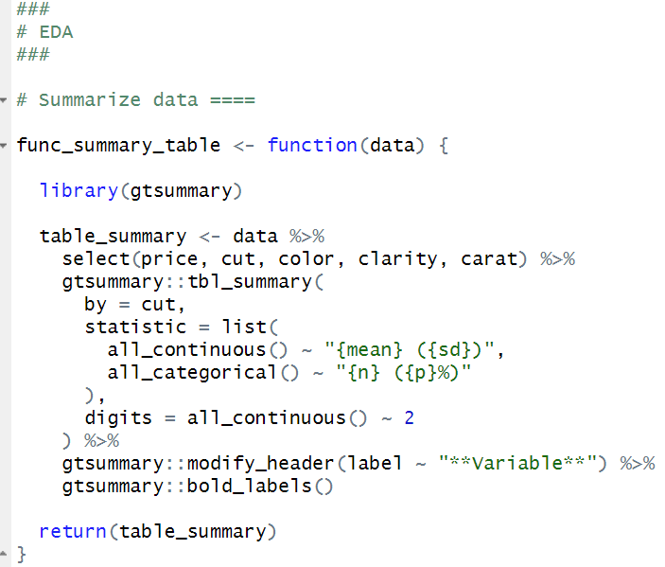
EDA
Function that creates summary table

Slide 50
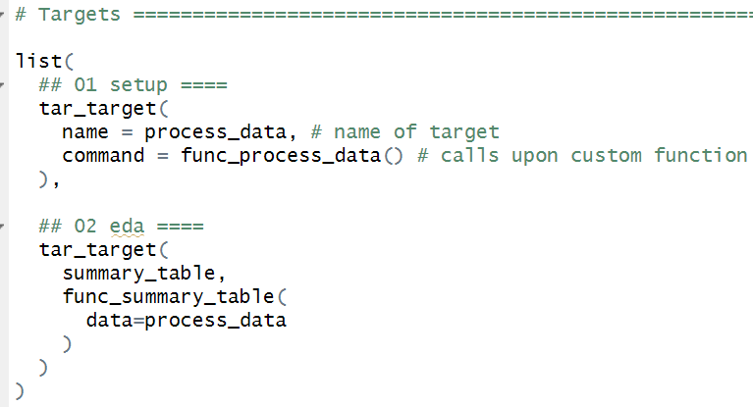
EDA
Function that creates summary table
Add function to a separate target

Slide 51
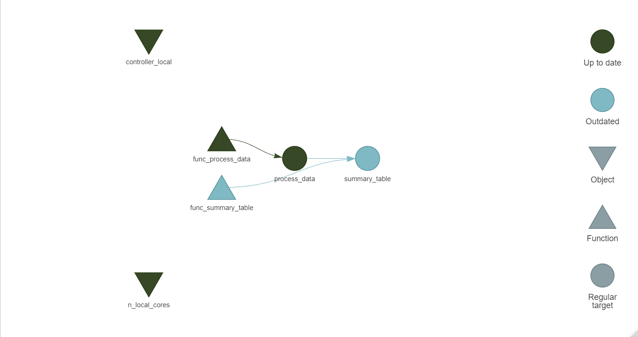
EDA
Function that creates summary table
Add function to a separate target

Slide 52
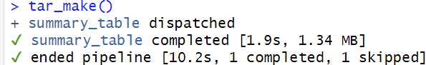
EDA
Function that creates summary table
Add function to a separate target
Run t a r g e t s workflow!

Slide 53
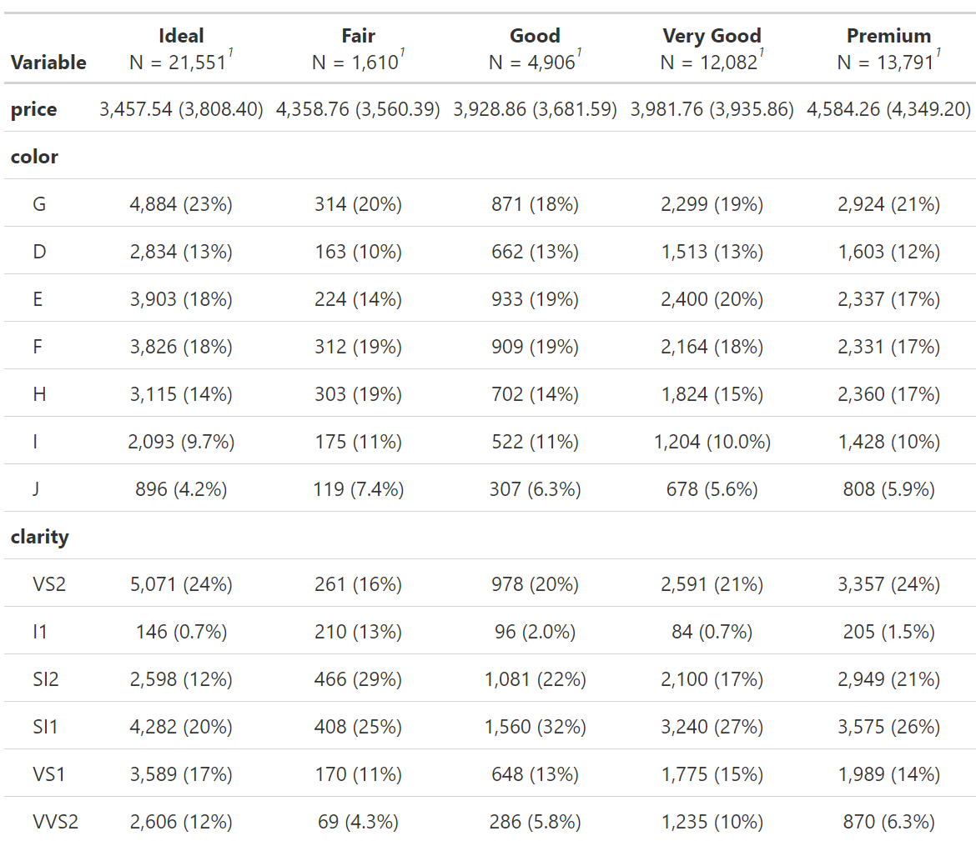
EDA
Function that creates summary table
Add function to a separate target
Run t a r g e t s workflow!

Slide 54
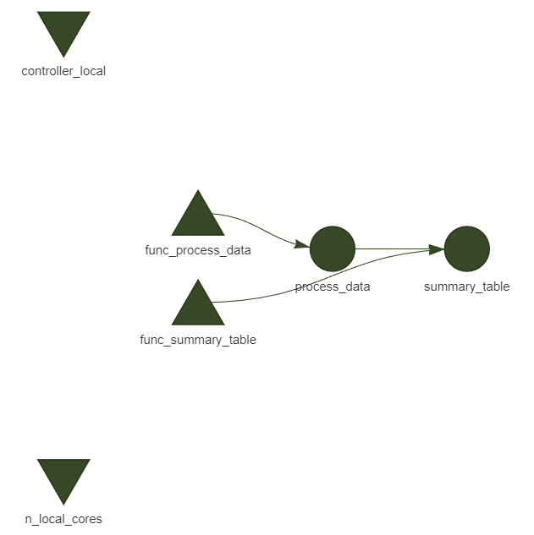
EDA
Function that creates summary table
Add function to a separate target
Run t a r g e t s workflow!

Slide 55
EDA further

Slide 56
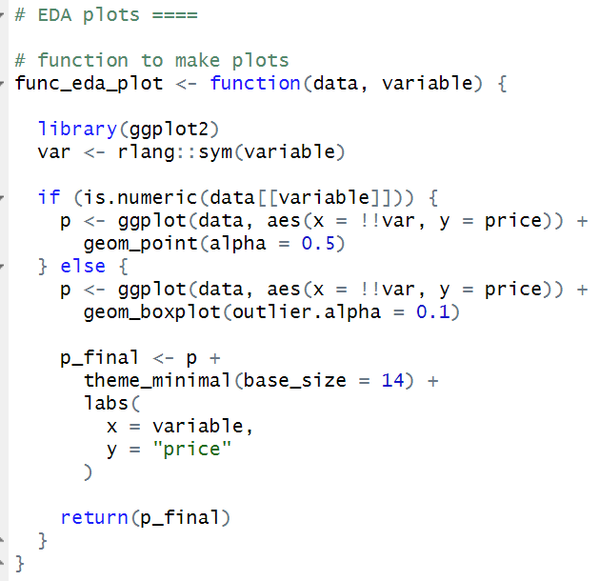
EDA further
Function that creates eda plots of a given variable by price

Slide 57
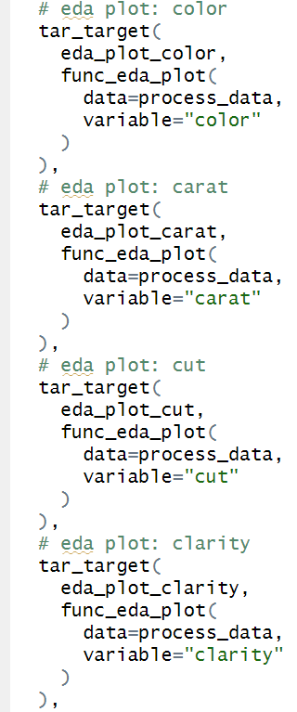
EDA further
Function that creates eda plots of a given variable by price
Create a target for each plot

Slide 58
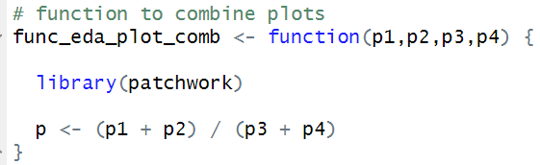
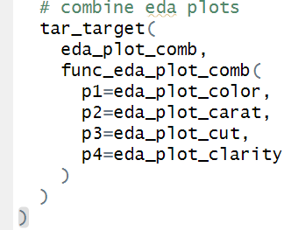
EDA further
Function that creates eda plots of a given variable by price
Create a target for each plot
Function and target that combines plots

Slide 59
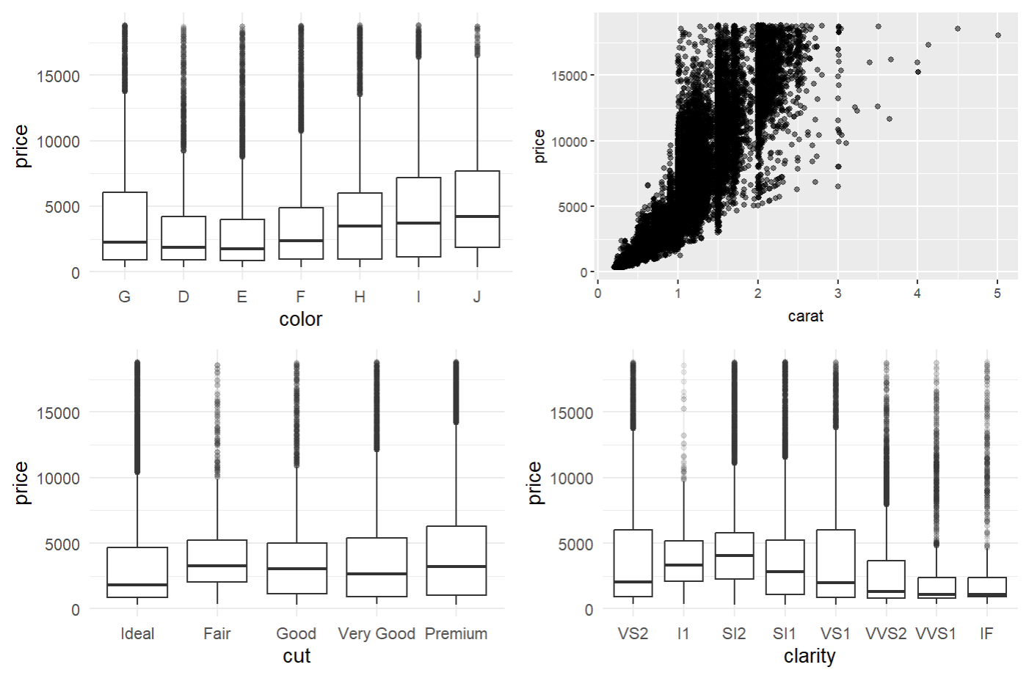
EDA further
Function that creates eda plots of a given variable by price
Create a target for each plot
Function and target to combine plots
Run t a r g e t s workflow!

Slide 60
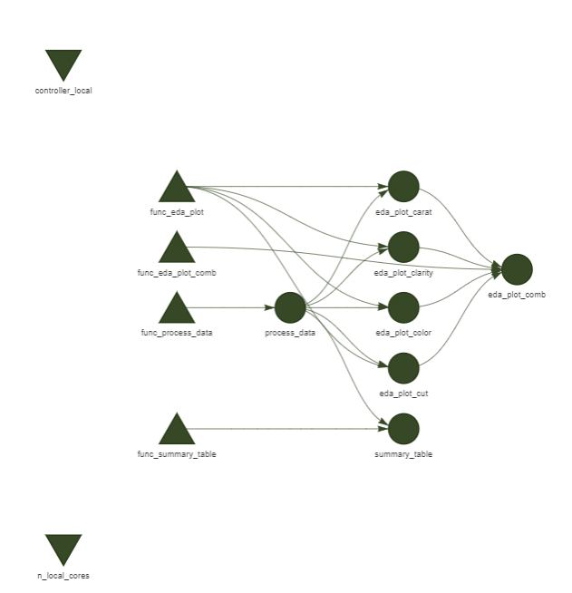
EDA further
Function that creates eda plots of a given variable by price
Create a target for each plot
Function and target that combines plots
Run t a r g e t s workflow!

Slide 61
Fit a model

Slide 62
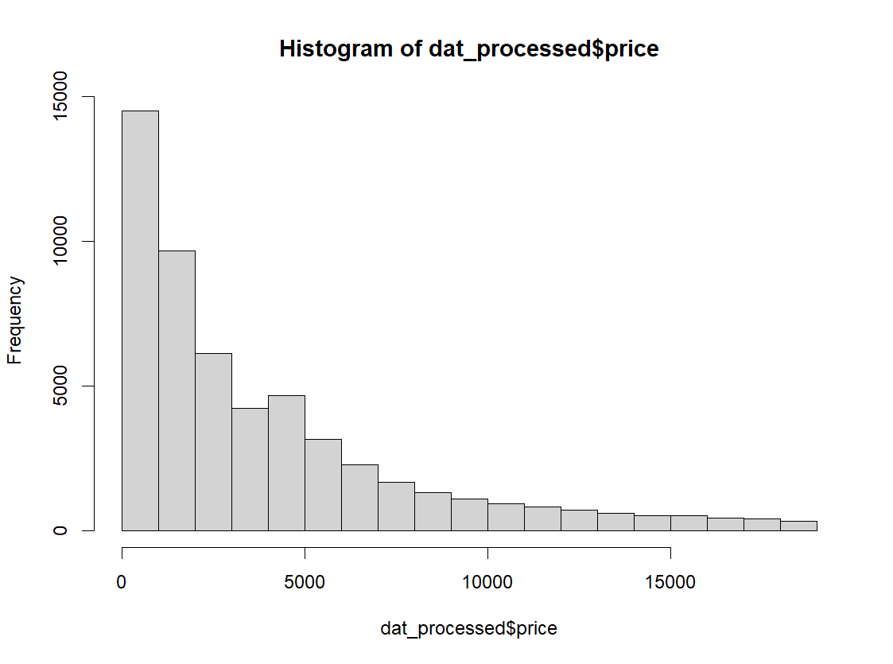
Fit a model
Data are right-skewed so fit gamma regression model with carat, cut, color, and clarity as predictors of price

Slide 63
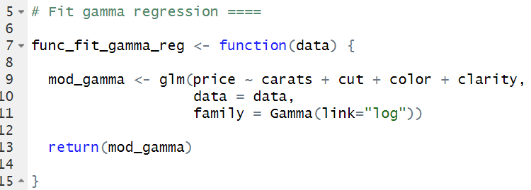
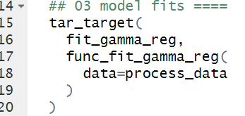
Fit a model
Data are right-skewed so fit gamma regression model with carat, cut, color, and clarity as predictors of price

Slide 64
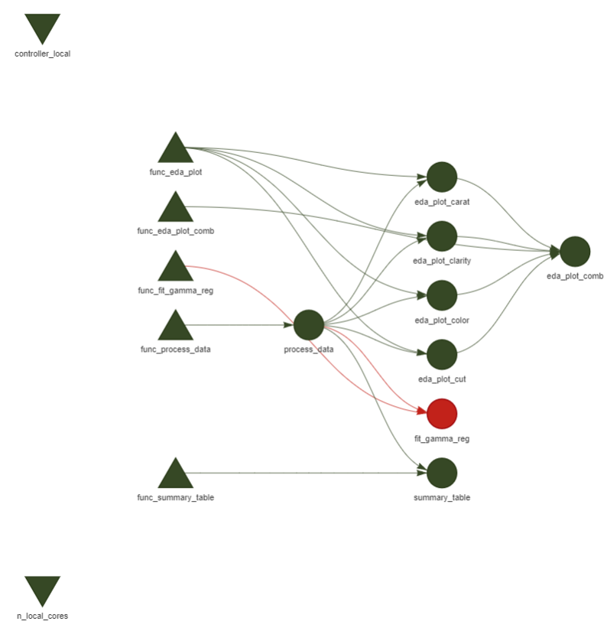
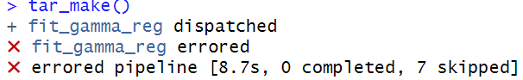
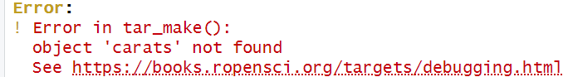
ERROR

Slide 65
Debugging in t a r g e t s

Slide 66
Debugging in t a r g e t s
Debugging in R is easiest when the session is interactive ie you have full control over the code and objects in the environment, and you are free to tinker and test until you find the issue

Slide 67
Debugging in t a r g e t s
Debugging in R is easiest when the session is interactive ie you have full control over the code and objects in the environment, and you are free to tinker and test until you find the issue
However, we intentionally use a non-interactive setup with targets because it is more automated and reproducible

Slide 68
Debugging in t a r g e t s
Debugging in R is easiest when the session is interactive ie you have full control over the code and objects in the environment, and you are free to tinker and test until you find the issue
However, we intentionally use a non-interactive setup with targets because it is more automated and reproducible
In this case, the targets error message was pretty informative but that doesn’t always happen

Slide 69
Debugging in t a r g e t s
Debugging in R is easiest when the session is interactive ie you have full control over the code and objects in the environment, and you are free to tinker and test until you find the issue
However, we intentionally use a non-interactive setup with targets because it is more automated and reproducible
In this case, the targets error message was pretty informative but that doesn’t always happen
Debugging your functions in targets sometimes requires a few extra steps

Slide 70
Debugging in t a r g e t s
Option 1
Recall: when we defined the crew controller for local workers, we asked each worker to create a log file and store it in the /logs folder

Slide 71
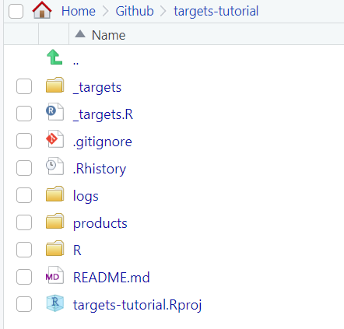
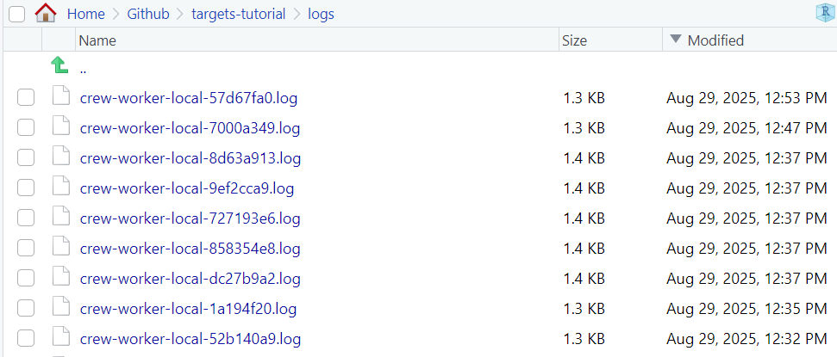
Debugging in t a r g e t s
Option 1
Recall: when we defined the crew controller for local workers, we asked each worker to create a log file and store it in the /logs folder
When you encounter an error with little explanation, one option is to go to the most recent log and you’ll find a more detailed report

Slide 72
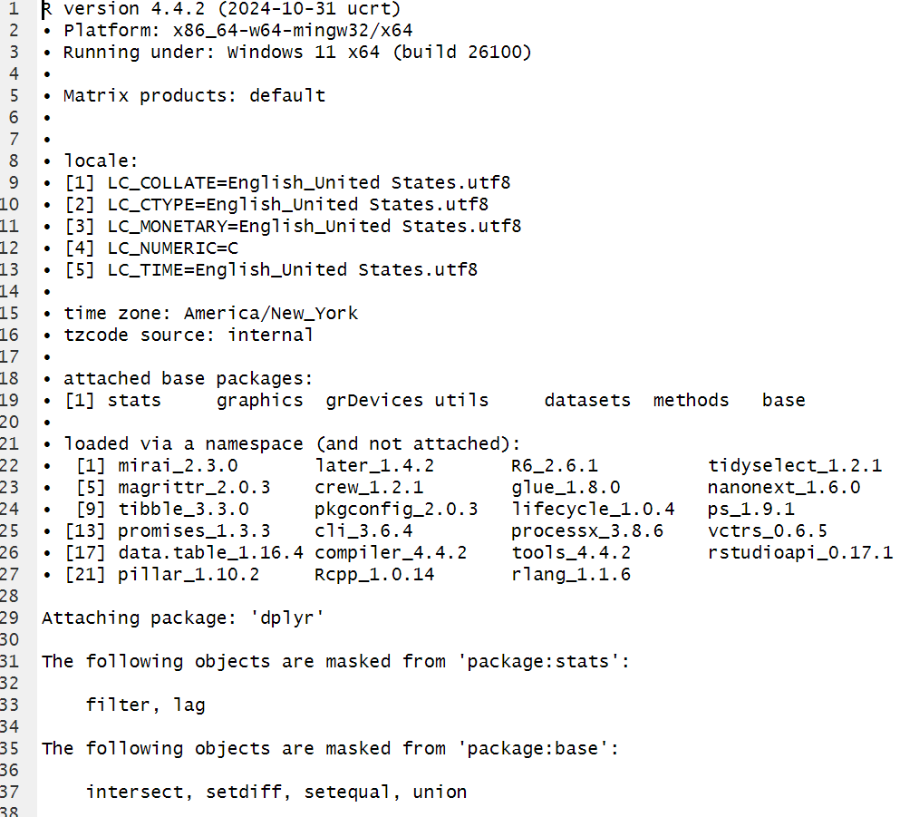
Debugging in t a r g e t s
Lots of session info that can be useful depending on what you’re doing
Not super informative for debugging in this case because the code is so simple but can be very helpful for more complex analyses.

Slide 73
Debugging in t a r g e t s
Option 2
Pause the pipeline with browser()

Slide 74
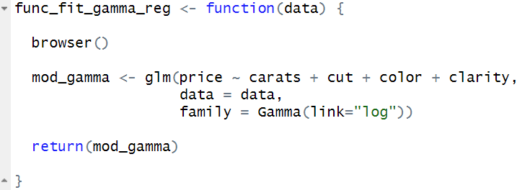
Debugging in t a r g e t s
Option 2
Pause the pipeline with browser()
Insert browser() into your errored function

Slide 75
Debugging in t a r g e t s
Option 2
Pause the pipeline with browser()
Insert browser() into your errored function and save
Call tar_make() with callr_function = NULL, use_crew = FALSE, and as_job = FALSE
This runs the whole pipeline in your interactive session without launching a new callr::r() process, parallel crew workers, or an RStudio job

Slide 76
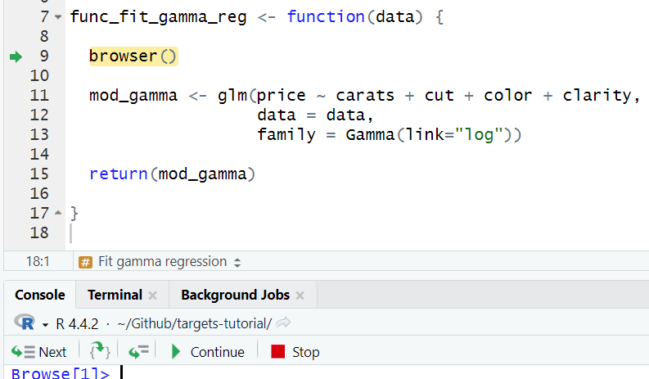
Debugging in t a r g e t s
Call tar_make() with callr_function = NULL, use_crew = FALSE, and as_job = FALSE

Slide 77
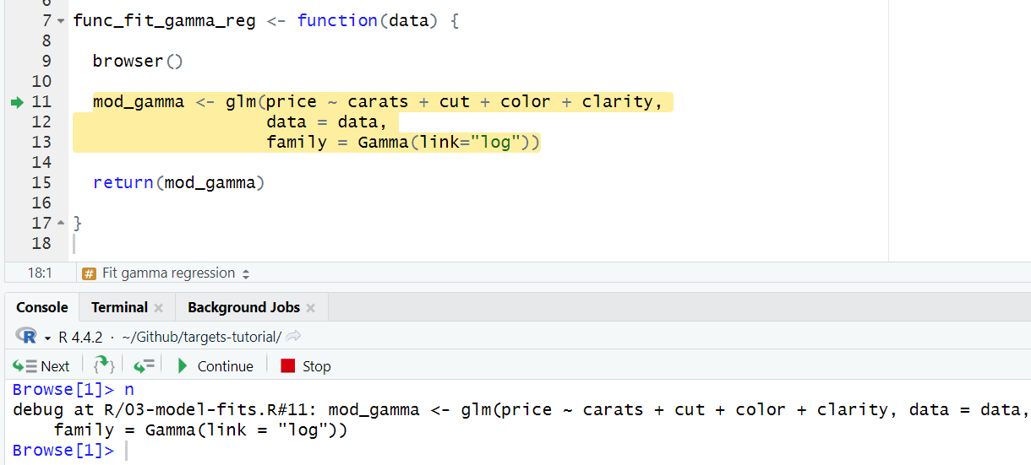
Debugging in t a r g e t s
Call tar_make() with callr_function = NULL, use_crew = FALSE, and as_job = FALSE

Slide 78
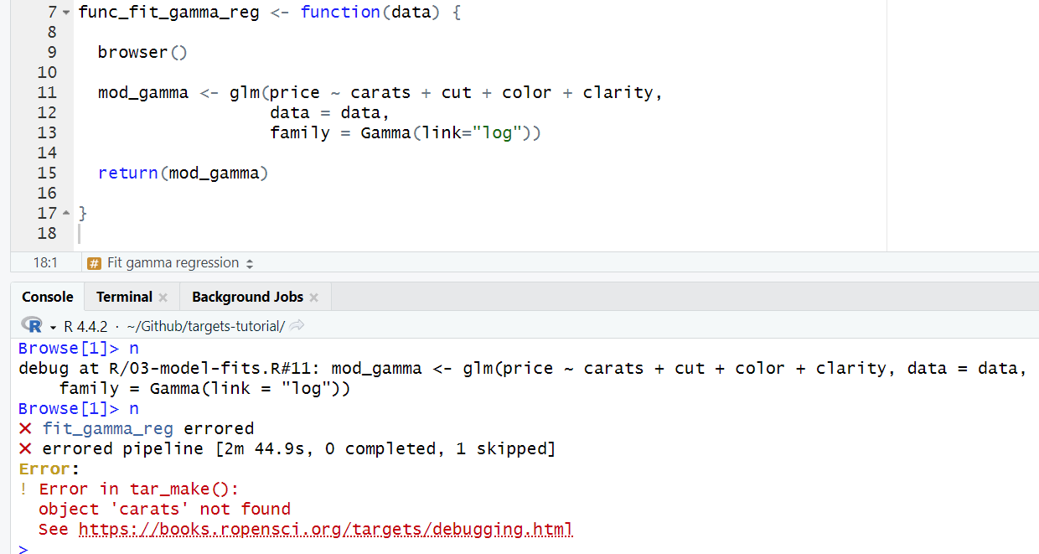
Debugging in t a r g e t s
Call tar_make() with callr_function = NULL, use_crew = FALSE, and as_job = FALSE

Slide 79


Debugging in t a r g e t s
We’ve located the line that contains the error
Replace the misspelled variable and rerun tar_make()

Slide 80
Results

Slide 81


Results
Function to make an interpretable figure of our results

Slide 82
Results
Function to make an interpretable figure of our results

Slide 83


Results
Function to make an interpretable figure of our results
Make a target and run

Slide 84


Results
Function to make an interpretable figure of our results
Make a target and run

Slide 85
Now we have an efficient, organized, and fully reproducible workflow!

Slide 86
Lastly…using t a r g e t s with the UGA sapelo2 cluster

Slide 87
Lastly…using t a r g e t s with the UGA sapelo2 cluster
Sapelo2 is high‐performance computing (HPC) Linux cluster run by the Georgia Advanced Computing Resource Center (GACRC) at UGA
I.e. a super-computer

Slide 88
Lastly…using t a r g e t s with the UGA sapelo2 cluster
Sapelo2 is high‐performance computing (HPC) Linux cluster run by the Georgia Advanced Computing Resource Center (GACRC) at UGA
I.e. a super-computer
It has about 38,000 CPU cores (compared to your laptop or desktop which probably has 4-16) and a bunch of different nodes

Slide 89
Lastly…using t a r g e t s with the UGA sapelo2 cluster
Sapelo2 is high‐performance computing (HPC) Linux cluster run by the Georgia Advanced Computing Resource Center (GACRC) at UGA
I.e. a super-computer
It has about 38,000 CPU cores (compared to your laptop or desktop which probably has 4-16) and a bunch of different nodes
More cores + more nodes = super fast and efficient computing😊

Slide 90
Lastly…using t a r g e t s with the UGA sapelo2 cluster
Sapelo2 is high‐performance computing (HPC) Linux cluster run by the Georgia Advanced Computing Resource Center (GACRC) at UGA
I.e. a super-computer
It has about 38,000 CPU cores (compared to your laptop or desktop which probably has 4-16) and a bunch of different nodes
More cores + more nodes = super fast and efficient computing😊
Any UGA student or faculty member can use it once you take a short training course

Slide 91
Using t a r g e t s with the UGA sapelo2 cluster
As an example, lets run the diamond pipeline on the cluster:

Slide 92


Using t a r g e t s with the UGA sapelo2 cluster
As an example, lets run the diamond pipeline on the cluster:
Invalidate the targets that have already been run (and push changes to github)

Slide 93

Using t a r g e t s with the UGA sapelo2 cluster
As an example, lets run the diamond pipeline on the cluster:
Log into the cluster and change to the scratch/ directory

Slide 94
Using t a r g e t s with the UGA sapelo2 cluster
As an example, lets run the diamond pipeline on the cluster:
Log into the cluster and change to the scratch/ directory
Clone your github project to sapelo2
Note that you need to generate a personal access token in github and give it repo scope

Slide 95

Using t a r g e t s with the UGA sapelo2 cluster
As an example, lets run the diamond pipeline on the cluster:
Log into the cluster and change to the scratch/ directory
Clone your github project to sapelo2
Write your slurm script
Note: make sure all necessary packages are installed in R on the cluster

Slide 96
Using t a r g e t s with the UGA sapelo2 cluster
As an example, lets run the diamond pipeline on the cluster:
Log into the cluster and change to the scratch/ directory
Clone your github project to sapelo2
Write your slurm script
Submit your job

Slide 97

Using t a r g e t s with the UGA sapelo2 cluster
As an example, lets run the diamond pipeline on the cluster:
Log into the cluster and change to the scratch/ directory
Clone your github project to sapelo2
Write your slurm script
Submit your job
Push back to Github

Slide 98
Using t a r g e t s with the UGA sapelo2 cluster
As an example, lets run the diamond pipeline on the cluster:
Log into the cluster and change to the scratch/ directory
Clone your github project to sapelo2
Write your slurm script
Submit your job
Push back to Github
Note: you might get an error about github not recognizing you. Just add your name and email

Slide 99


Using t a r g e t s with the UGA sapelo2 cluster
As an example, lets run the diamond pipeline on the cluster:
Log into the cluster and change to the scratch/ directory
Clone your github project to sapelo2
Write your slurm script
Submit your job
Push back to Github
GitKraken via my desktop:

Slide 100
Using t a r g e t s with the UGA sapelo2 cluster
As an example, lets run the diamond pipeline on the cluster:
Log into the cluster and change to the scratch/ directory
Clone your github project to sapelo2
Write your slurm script
Submit your job
Push back to Github
Check pipeline status

Slide 101

Using t a r g e t s with the UGA sapelo2 cluster
As an example, lets run the diamond pipeline on the cluster:
Log into the cluster and change to the scratch/ directory
Clone your github project to sapelo2
Write your slurm script
Submit your job
Push back to Github
Check pipeline status

Slide 102
Using t a r g e t s with the UGA sapelo2 cluster
As an example, lets run the diamond pipeline on the cluster:
Log into the cluster and change to the scratch/ directory
Clone your github project to sapelo2
Write your slurm script
Submit your job
Push back to Github
Check pipeline status
What?! Why are the targets outdated???

Slide 103
Using t a r g e t s with the UGA sapelo2 cluster
From what I can tell…

Slide 104
Using t a r g e t s with the UGA sapelo2 cluster
From what I can tell…
Even though you might connect to Sapelo2 from your desktop, t a r g e t s treats Sapelo2 and your local machine as separate environments, each with its own _targets/ cache

Slide 105
Using t a r g e t s with the UGA sapelo2 cluster
From what I can tell…
Even though you might connect to Sapelo2 from your desktop, t a r g e t s treats Sapelo2 and your local machine as separate environments, each with its own _targets/ cache
Basically, only use Sapelo2 to run the t a r g e t s pipeline when you have computationally expensive or large models (which you probably would do anyways).

Slide 106
Using t a r g e t s with the UGA sapelo2 cluster
From what I can tell…
Even though you might connect to Sapelo2 from your desktop, t a r g e t s treats Sapelo2 and your local machine as separate environments, each with its own _targets/ cache
Basically, only use Sapelo2 to run the t a r g e t s pipeline when you have computationally expensive or large models (which you probably would do anyways).
(Unfortunately) it’s all-or-nothing: if you need to run one part of the pipeline on the cluster, it seems like you need to run the entire pipeline there.

Slide 107
Using t a r g e t s with the UGA sapelo2 cluster
From what I can tell…
Even though you might connect to Sapelo2 from your desktop, t a r g e t s treats Sapelo2 and your local machine as separate environments, each with its own _targets/ cache
Basically, only use Sapelo2 to run the t a r g e t s pipeline when you have computationally expensive or large models (which you probably would do anyways).
(Unfortunately) it’s all-or-nothing: if you need to run one part of the pipeline on the cluster, it seems like you need to run the entire pipeline there.
Fortunately, the brilliant t a r g e t s automated workflow basically forces this anyway!

Slide 108
Using t a r g e t s with the UGA sapelo2 cluster
From what I can tell…
Even though you might connect to Sapelo2 from your desktop, t a r g e t s treats Sapelo2 and your local machine as separate environments, each with its own _targets/ cache
Basically, only use Sapelo2 to run the t a r g e t s pipeline when you have computationally expensive or large models (which you probably would do anyways).
(Unfortunately) it’s all-or-nothing: if you need to run one part of the pipeline on the cluster, it seems like you need to run the entire pipeline there.
Fortunately, the brilliant t a r g e t s automated workflow basically forces this anyway!
In theory, you could transfer the _targets/ cache across devices to explore model results, but for large models the files are too big to move easily and doing so via github will probably just set flames to Miller Hall🔥

Slide 109





Congratulations
You now know how to code using t a r g e t s
e
was
started
Slides and code available on my GitHub
https://github.com/murphyhjohn/targets-tutorial

